Slide 1
AIMS Tutorial

Slide 2
Follow the following, step by step every time you are using the Sequencer. (except for the part where you make your sequence)

Slide 3
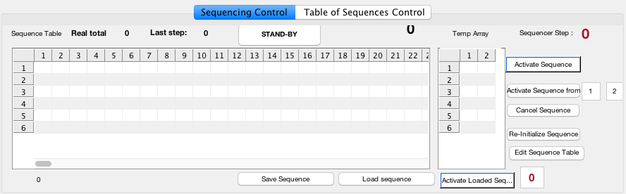
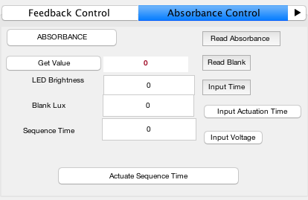
Making Sequence (1)
Toggle Absorbance ON.

Slide 4
Special Character in Sequence Table (2)
Make a sequence like you would normally do. To read absorbance, you need to add “special characters” to the sequence table.
Add special characters by pressing these buttons: absorbance reading / pause time / blank reading / voltage change.
This allows special functions to be performed during the sequence actuation phase.
Make sure to input a blank reading character in the beginning of your sequence.

Slide 5
How to : Making Sequence (1)
Save your sequence using the button.

Slide 6
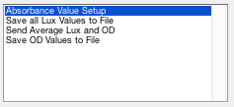
Make sure you input the : number of Readings and number to Average like usual.
This should be located in the absorbance tab, to the right of the camera image.

Slide 7
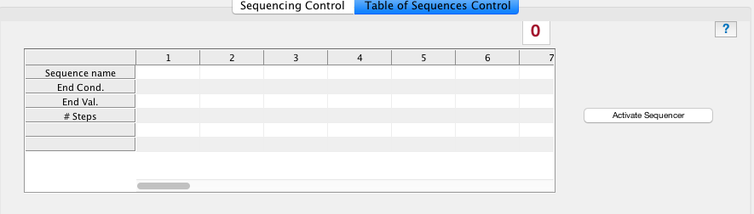
Sequencer Table (3)
Under Sequence name, just put the name of the sequence you put when you saved it. (ie. Saved name = sequence_nam -> I would input ‘nam’ only)
End Cond. (End Condition) : there are 3 end conditions –> Time / Cycle / OD -> input exactly like these names ^^ (ie. ‘Time’ but without apostrophes)
End Val. (End Value) : these are the values that the program will check and if met, will end that step in the table of sequences. If not met, it will continue the sequence in a loop.
Time -> (seconds)
Cycle -> (number of cycles)
OD -> (OD value)
# Steps. (Number of steps) : the number of steps in that sequence. (ie. Sequence_nam has 14 steps)
If you do not know the number of steps, just click on your sequence_name file and you should be able to figure it out.
Finally, input the number of steps you have in the Table of sequences here.
Activate using this.

